Slide 1
CONSTRUCTION PROJECT MANAGEMENT
INDHUMATHI V (192124215)
P PRAGATHI (192111315)

Slide 2
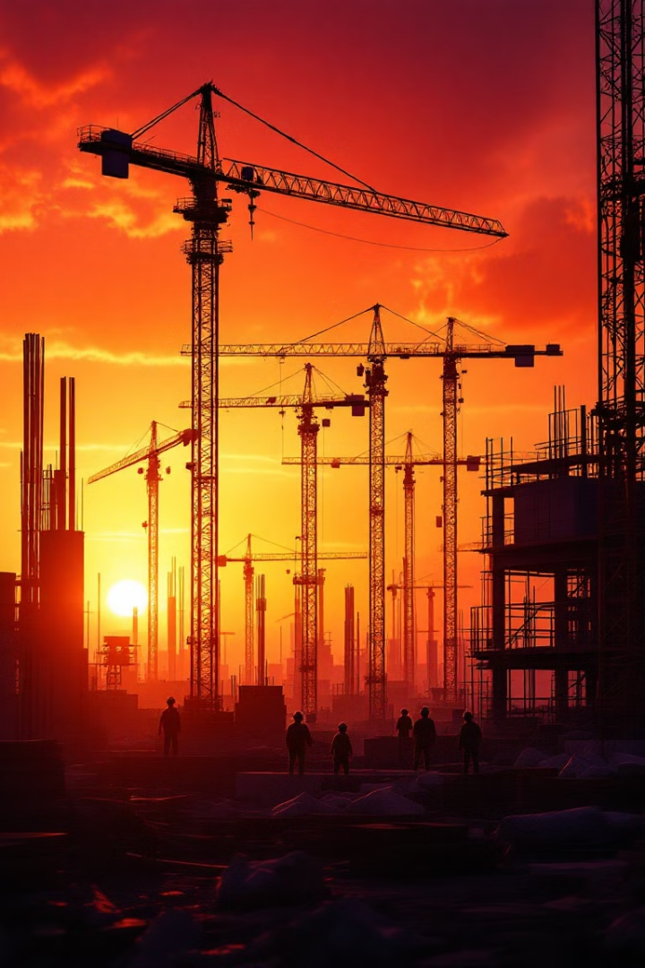
An Overview
This presentation outlines the implementation of a robust construction project management system. The system aims to track project timelines, material usage, and workforce allocation to generate real-time progress reports and facilitate budget tracking. The goal is to achieve less than 10% cost variance, reduce project delays, and improve resource management.

Slide 3
Problem Statement: Cost Overruns and Delays
Cost Overruns
Project Delays
Construction projects frequently exceed their allocated budgets due to unforeseen expenses, inefficient resource allocation, and inaccurate initial estimations. Uncontrolled spending threatens project profitability.
Delays arise from a multitude of factors, including weather disruptions, material shortages, and inadequate workforce management. Late project delivery leads to contractual penalties and reputational damage
These are the issues an integrated system would address. By improving cost control and avoiding delays, the system can contribute to improved outcomes.

Slide 4

Proposed Solution: Integrated Tracking System
Centralized Data
The system consolidates project information into a single, accessible database, fostering transparency and collaboration among stakeholders. Avoids data silos.
Automated Processes
Automated workflows streamline tasks such as progress tracking, reporting, and invoice processing, freeing up project managers to focus on strategic decision-making.
Real-Time Visibility
Dashboards and reports provide stakeholders with up-to-date insights into project performance, enabling proactive identification and resolution of potential issues.
An integrated tracking system offers a streamlined way to manage resources and data.

Slide 5
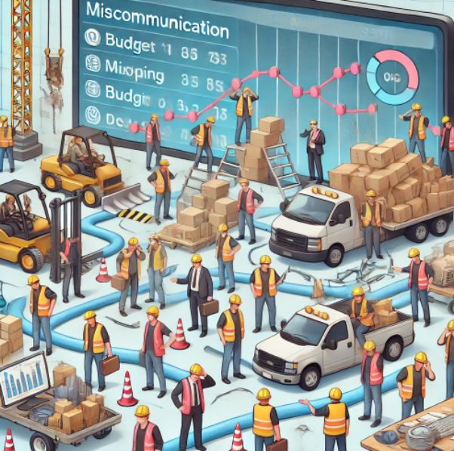
Challenges in Traditional Construction Management
1. Poor Communication
Lack of centralized communication leads to mismanagement.
Delayed approvals and unclear instructions affect productivity.
2. Lack of Real-Time Data
Project status updates are slow and outdated.
Decisions are based on assumptions rather than real-time insights.
3. Inefficient Resource Allocation
Manual tracking leads to workforce and material mismanagement.
Over-allocation or underutilization of resources increases costs.
4. Budget Overruns and Timeline Delays
Unforeseen costs and project scope changes cause budget fluctuations.
Poor planning leads to missed deadlines.

Slide 6
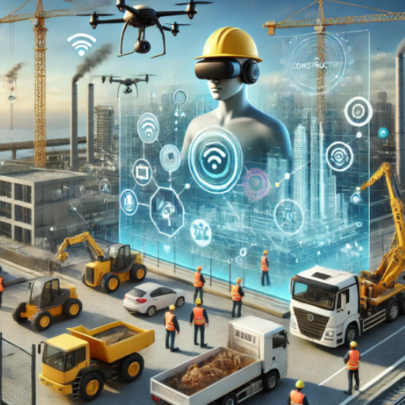
Technology Trends in Construction Management
1. Artificial Intelligence & Machine Learning
Predictive analytics for identifying risks before they impact the project.
AI-driven cost estimation for accurate budgeting.
2. IoT for Real-Time Monitoring
Sensors track equipment usage, worker safety, and environmental factors.
Smart wearables monitor workforce health and productivity.
3. Blockchain for Contract & Payment Security
Ensures transparency in payments and legal agreements.
Reduces fraud and disputes in procurement.
4. Augmented & Virtual Reality (AR/VR)
Digital simulations for project visualization before construction.
Helps in training workers with virtual on-site experience.

Slide 7
Traditional vs. Digital Project Management
Aspect | Traditional | Digital
Tracking | Manual logs, spreadsheets | Automated dashboards & databases
Communication | Phone calls, emails | Centralized real-time updates
Material Management | Paper records, stock mismatches | AI-based demand forecasting
Budget Control | Delayed cost analysis | Real-time expense tracking
Project Monitoring | Site visits, reports | Live progress dashboards

Slide 8
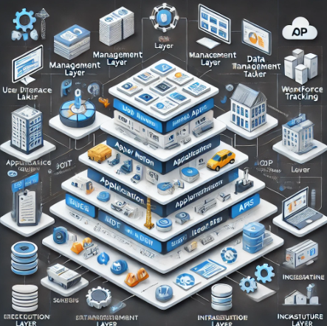
System Architecture
User Interface Layer:
Web & Mobile App
Dashboard for project managers
Role-based access for different stakeholders
Application Layer:
Task & timeline management
Workforce & resource tracking
Real-time reporting & analytics
Data Management Layer:
Database (SQL/NoSQL) for storing project details
Cloud storage for documents & blueprints
Backup & disaster recovery mechanisms
Integration Layer:
IoT sensors for material tracking
ERP integration for budgeting & cost tracking
API connectivity for third-party tools
Infrastructure Layer:
Cloud-based deployment (AWS, Azure, or GCP)
Security measures (encryption, authentication)
Scalability for handling multiple projects

Slide 9
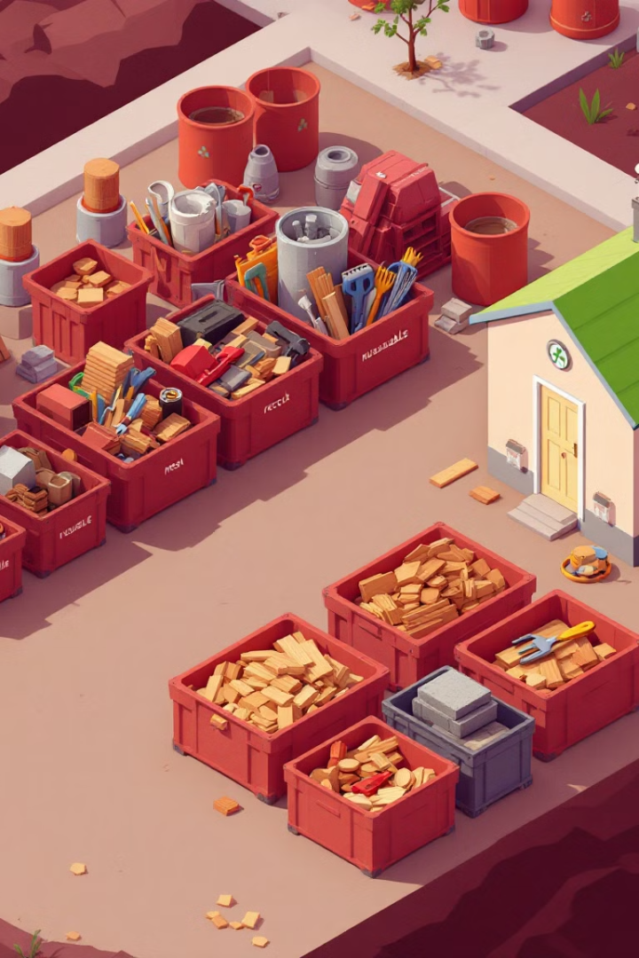



System Features: Material Usage & Waste Reduction
Inventory Management
Track material quantities, locations, and consumption rates to optimize inventory levels and minimize stockouts or excess inventory.
Waste Tracking
Monitor waste generation and disposal methods to identify opportunities for waste reduction and promote sustainable practices. Recycling reports for compliance.
Cost Analysis
Analyze material costs, waste disposal expenses, and potential savings from waste reduction initiatives. Understand the economic impact of material management.
Waste reduction will contribute to improved resource utilization and sustainability.

Slide 10
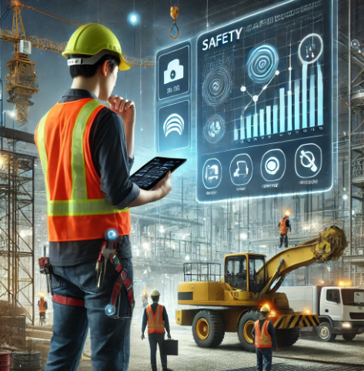
Safety and Compliance Tracking
1. OSHA & Legal Compliance
Automated reporting for safety standards compliance.
Reduces legal penalties and ensures worker protection.
2. Worker Safety Monitoring
Smart helmets and wearables detect hazards and fatigue.
Alerts prevent accidents by tracking unsafe working conditions.
3. Incident Tracking & Reporting
Real-time reporting of on-site accidents.
Data analytics help identify recurring safety risks.
4. Emergency Preparedness
AI-driven simulations for risk mitigation.
Digital documentation of safety protocols.

Slide 11




System Features: Workforce Allocation and Optimization
Skill Matching
Assign personnel to tasks based on their skills, experience, and availability to maximize productivity and minimize errors.
Resource Leveling
Balance workload across teams to avoid bottlenecks and ensure equitable distribution of resources.
1
2
Availability
Ensure there are enough trained workers available to accomplish tasks. Monitor certifications.
Time Tracking
Monitor employee hours and productivity to identify areas for improvement and ensure compliance with labor regulations.
4
3
Optimal workforce allocation and management improve outcomes and reduce labor costs.

Slide 12
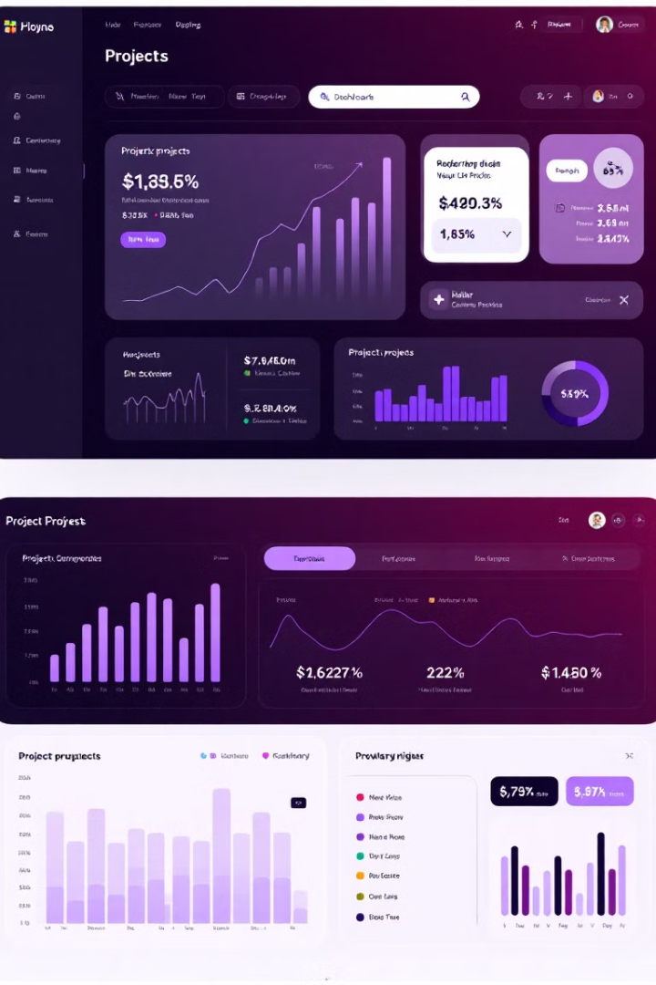
Real-Time Progress Reporting and Dashboards
Progress Tracking
Real-time updates on task completion, milestone achievement, and overall project status, providing stakeholders with an accurate picture of progress.
Performance Metrics
Key performance indicators (KPIs) such as cost variance, schedule adherence, and resource utilization, enabling proactive identification of areas needing attention.
Customizable Reports
Tailored reports catering to the specific needs of different stakeholders, providing the right level of detail and insight. Reports are easily exported.
Real-time progress reports are essential for proactive issue identification.

Slide 13
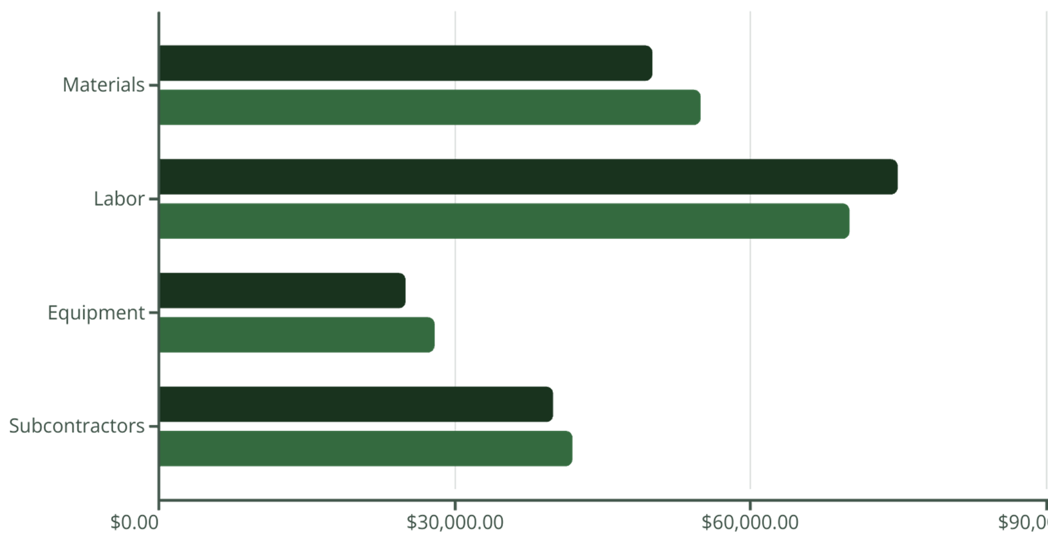
Budget Tracking and Cost Variance Analysis (<10% Target)
Budgeted
Actual
The system tracks expenses against the budget. Cost variance analysis will identify overspending and underspending. The target is less than 10% cost variance.

Slide 14
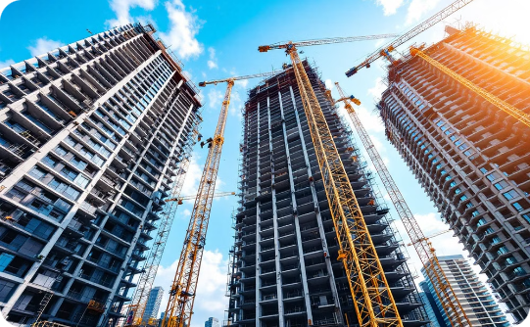
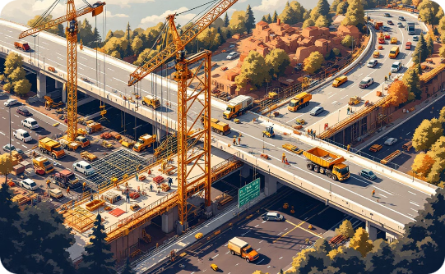
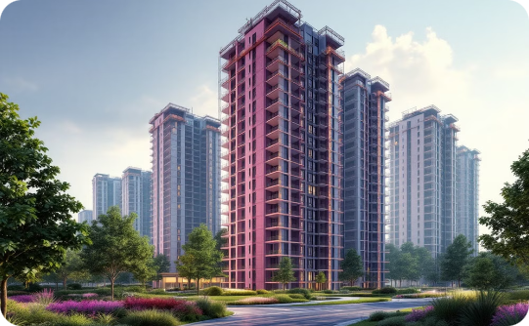
Case Studies: Impact on 10+ Projects
Infrastructure Project
The project achieved a 8% reduction in labor costs and a 5% reduction in overall project budget. Optimized resources.
Residential Complex
The project realized a 12% reduction in waste generation and a 7% reduction in project timeline. Reduced materials.
High-Rise Project
The project realized a 15% reduction in material costs and a 10% reduction in project duration. Integrated system.
These case studies demonstrate the positive impacts of the integrated project management system.

Slide 15



ROI & Next Steps: Reduced Delays, Improved Resource Management
Increased Profitability
Improved project margins
1
Enhanced Efficiency
Streamlined processes
2
Reduced Delays
3
On-time project delivery
The return on investment (ROI) includes reduced delays and improved resource management. Next steps include system implementation, data migration, and user training.

Slide 16
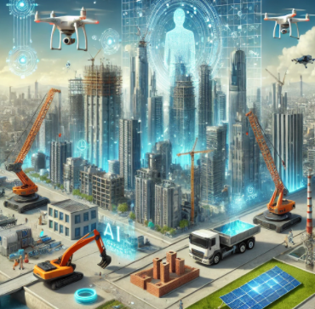
Future Scope of Smart Construction Management
1. AI-Powered Automation
AI bots for schedule optimization and resource allocation.
Self-healing concrete and AI-monitored maintenance.
2. Robotics in Construction
Autonomous machines for bricklaying, excavation, and welding.
Drones for site surveillance and progress tracking.
3. Digital Twins Technology
Virtual models of construction projects for real-time updates.
Detects design flaws before execution.
4. Sustainability & Green Construction
AI-driven energy-efficient building designs.
Smart grids to reduce environmental impact.

